Slide 1

Fraud Transaction Detection
A machine learning project which tells a particular transaction is fraud or not. This project is under ineuron internship.

Slide 2
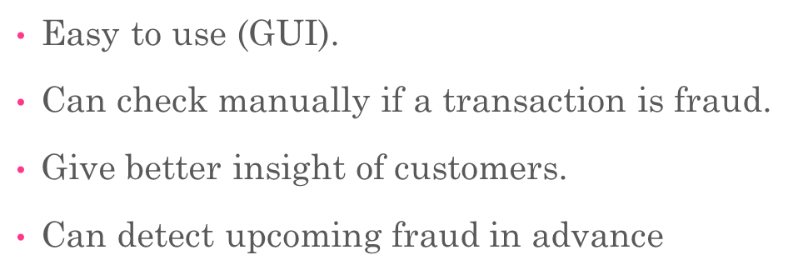
Objective
A machine learning model that predicts whether a particular transaction is fraud or not.
Benefits

Slide 3
Project Steps
Collecting data
Pre-processing data
Choosing a model.
Create pipeline
Training the model.
Evaluating the model.
Making predictions
Front-end part (templates folder).
Flask app
Deployment

Slide 4
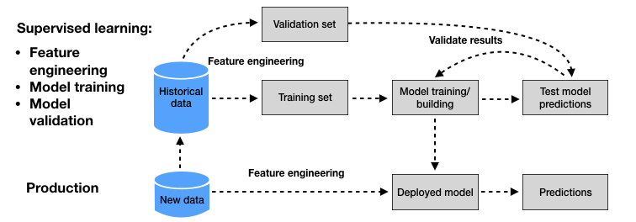
Supervised Machine Learning

Slide 5
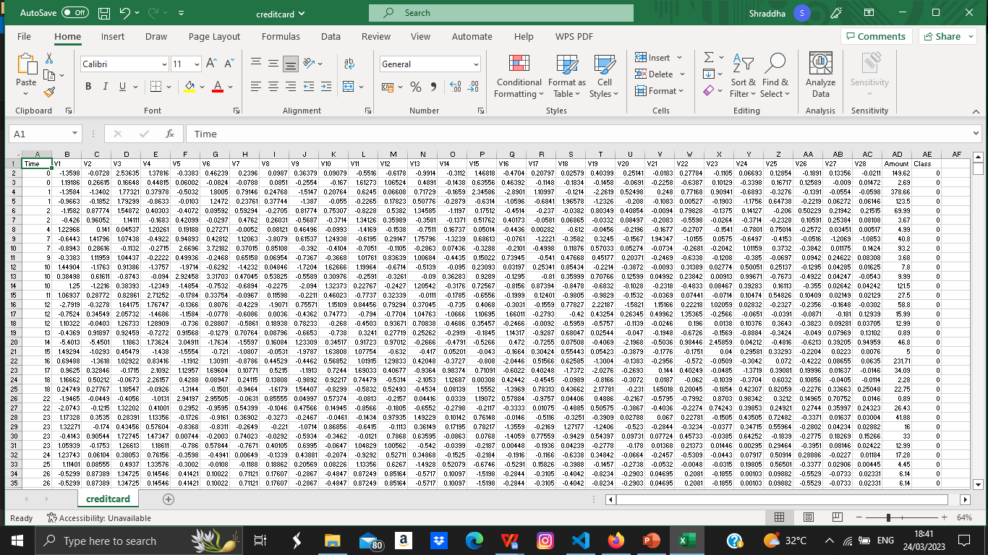
Dataset

Slide 6
Data Pre-processing
Performing EDA to get insight of data like identifying distribution, statistics , outlier among data etc.
Check for null values in the columns. If present impute the null values.
Visualizing scatter plot of independent variables with each other and output variables.
Perform Standard Scalar to scale down the values.
Perform PCA .

Slide 7
Pipeline And Choosing a Model
Create pipeline:- Created pipeline for every model (Logistic regression, Gradient boosting classifier, Random forest classifier, etc.)
Model selection :- We find the best model for each pipeline. For each pipeline, we used hyper tuned algorithms. After calculating the AUC scores for all pipeline models
We select the model with the best score.
Random forest found the best accuracy and did prediction.

Slide 8
Model Training
Before diving the data in training and validation set we performed preprocessing and featuring scaling.
The scaling was performed over training and validation data
Algorithms like K-mean, XGBoost, Random Forest etc were used and select our final model and we saved that as Model.pkl.
We splitted our datset in training and testing set.
We have found “Random forest” best fit for our data.
Train the selected model and test the prediction on test data.
Used performance metrices to evaluate the model.
For evaluating model we want accuracy_score, confusion_matrix.

Slide 9
Make Predictions And Evaluation
We have found “Random forest” best fit for our data.
Train the selected model and test the prediction on test data.
Loaded model after that performed prediction. At the end we got the output data of predictions.
Used performance metrices to evaluate the model.
For evaluating model we want accuracy_score, confusion_matrix.

Slide 10
Front-end of Project
Created “index.html”
Created Form for our features (independent variables) and used “Post” method.
We feed all that data to our saved best fit model ( Random forest model).
Then if our output is “0” then our transaction is not a fraud transaction otherwise it is a fraud transaction.
Display this result on screen.

Slide 11
Deploy App
Created a flask app.
When the model is ready we deploy it in Fire environment.
When we get sign off from Fire then deploy it in Earth and UAT is performed over it.
After getting the sign off from Earth we deploy in production.

Slide 12
Thanks For Wonderful Opportunity
This is great opportunity and this internship is great kick-start of my career in Machine Learning. This internship cleared lot of concepts in machine learning.
Special Thanks To Ineuron Team.
Mentors-: Sudhanshu Kumar, Krish Naik

